Slide 1
Personality Detection From Text - Final Year Project
Under the guidance and mentorship of
Sir Amitabha Acharya
Group Members
Mayukh Mitra(1851005), Pushan Pore(1851012),
Manjari Nandi Majumdar (1851039) and Srinjoy Paul (1851062)

Slide 2




Individual contributions in team work
Mayukh Mitra
1851005
Data Preprocessing
Document Level Feature Extraction
ML Approach
Pushan Pore
1851012
Data Cleaning
Data Filtering
Feature Extraction
Deep Learning Approach
Manjari Nandi Majumdar
1851039
Word Level Feature Extraction
Word vectorization
Classification
Srinjoy Paul
1851062
Classification
Deep Learning Approach
Accuracy Enhancement

Slide 3
Motivation
Personality is a combination of an individual’s
behavior, emotion, motivation, and thought pattern. Our personality has a great impact on our mind, our behavior our course of. Knowing one’s personality can be very helpful in order to analyze one’s mental health.
Sentiment analysis plays a key role here. This project has far reaching real world applications like:
Product Recommendations by e-stores, mental health check ups, forensic application to understand criminal psychology, to detect criminal tendency, to detect depression and suicidal tendencies.

Slide 4
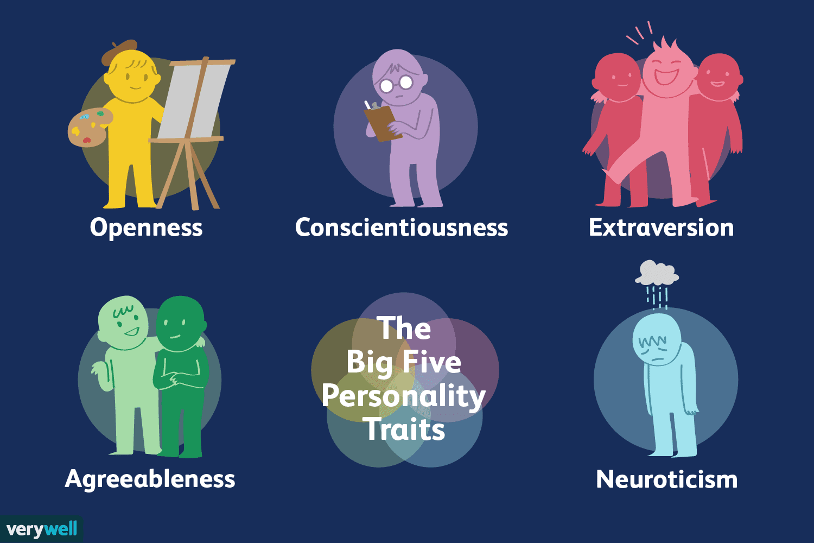
Key Concept- Five Factor Model
Personality is typically formally described in
terms of the Big Five personality traits, which are
the following binary (yes/no) values:
• Extraversion: Is the person outgoing, talkative,
and energetic versus reserved and solitary?
• Neuroticism: Is the person sensitive and
nervous versus secure and confident?
• Agreeableness: Is the person trustworthy,
straightforward, generous, and modest versus
unreliable, complicated, meager, and boastful?
• Conscientiousness: Is the person efficient and organized versus sloppy and careless?
• Openness: Is the person inventive and curious versus dogmatic and cautious?

Slide 5
Objective
In the 1970s two research teams led by Paul Costa and Robert R. McCrae of the National Institutes of Health and Warren Norman and Lewis Goldberg of the University of Michigan at Ann Arbor and the University of Oregon, respectively, discovered that most human character traits can be described using five dimensions. Surveys of thousands of people yielded these largely independent traits. The objective of this model is to detect the absence/presence of five different personality attributes based on texts gathered from various personalities.
Algorithm and Approach
We took two different approaches to implement our project, the first one is naïve based on Machine Learning and the other approach deals with Neural Networks which is based on Deep Learning.
I. Machine Learning Approach: In this approach we first clean the gathered data and store it in a dataframe, after that we remove the unwanted characters and words and pick-up the words which are then used to create the bag of words, then we convert the text in the form of vectors and then we build Bayes classifier model to train and test on our data and then finally we predict the output using the model built.
II. Deep Learning Approach: In this approach we first clean the gathered data and store it in a dataframe. We fed sentences from the essays to convolution filters to obtain the sentence. We represented each individual essay by aggregating the vectors of its sentences. We concatenated the obtained vectors with the Mairesse features,4 which were extracted from the texts directly at the preprocessing stage;
this improved the method’s performance. then we merge five target attributes into a single target attribute, after that we create the deep learning model of 4 layers using ANN, then we split the data into train and test dataset. After that we measure the accuracy based on the test data of the model built.

Slide 6
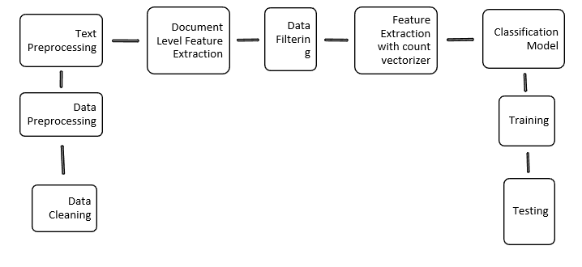
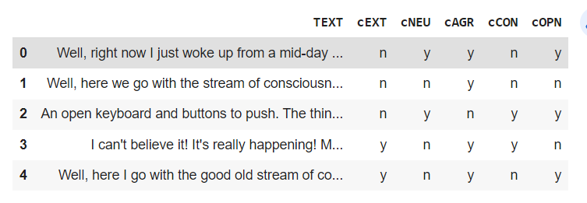
Project Overview
Data Preprocessing and Cleaning.
Text Preprocessing – coversion to lowercase, removing special characters.
Document Level Feature Extraction.
Data Filtering – removing stop words.
Feature Extraction with Count Vectorizer.
Classification Model Creation – Using both Naïve and Deep Learning Approach.
Training
Testing
DATASET

Slide 7
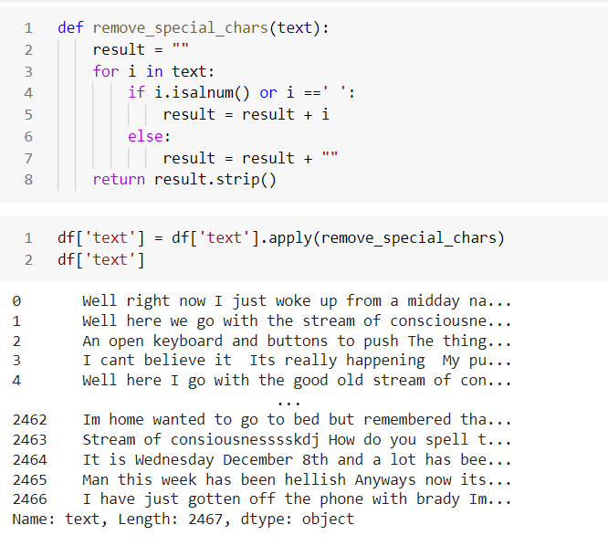
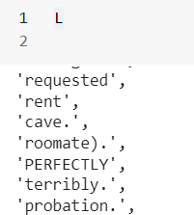
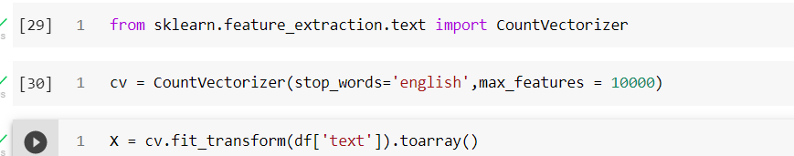
Approach 1 – Naïve Approach
Remove special characters: Making Bag of Words:
Vectorization:

Slide 8
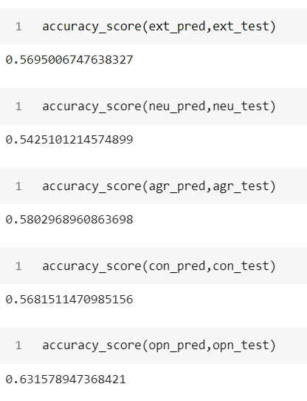
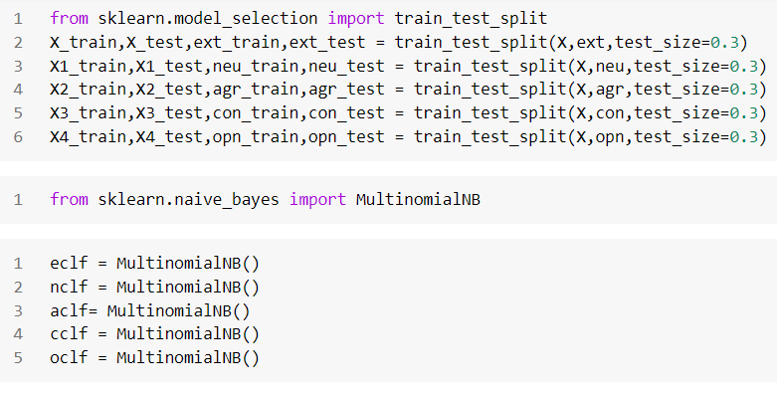
Approach 1 – Naïve Bayes
Use Multinomial Naïve Bayes Find Accuracy Score of the Model:
Classifier:
Extraversion: 0.59
Neuroticism:0.54
Agreeableness:0.58
Conscienticiousness:0.56
Openness: 0.63

Slide 9
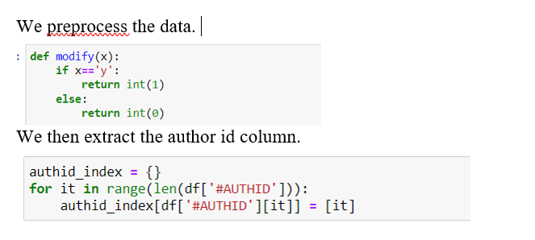
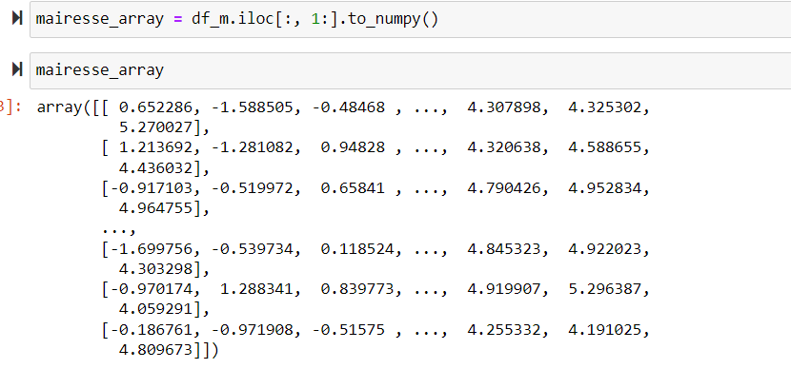
Approach 2 – Deep Learning
We used the Mairesse baseline feature set (10*85), which includes such global features as the word count and average sentence length. We append the author id with this set to uniquely identify the columns. We rename the columns for better understanding.
Next, we move on to Document Level Feature Extraction.

Slide 10
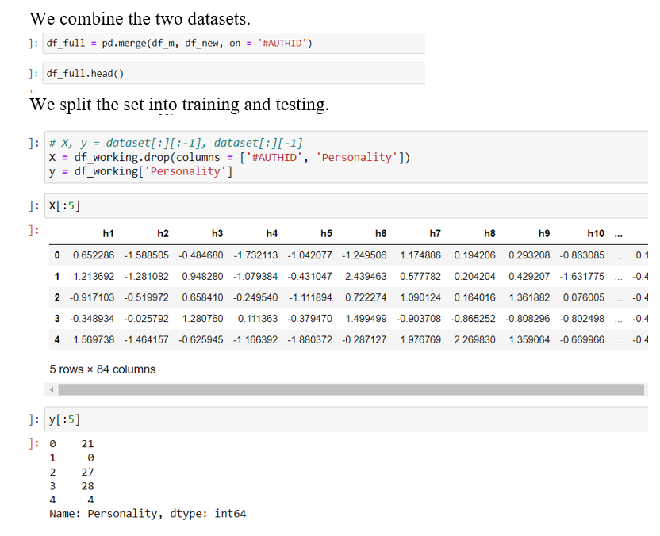
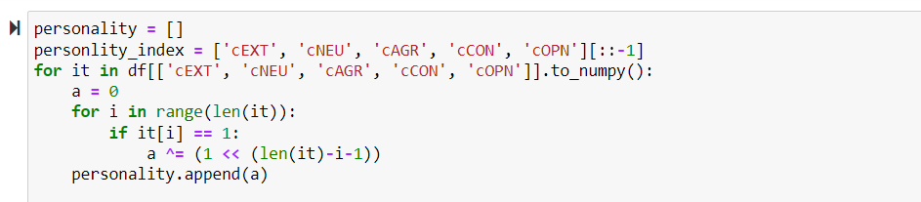
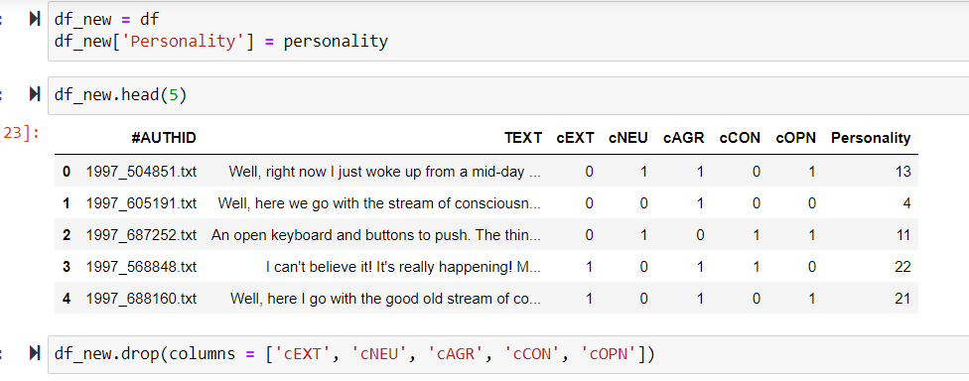
Approach 2 – Deep Learning
Converting 5 personality columns( corresponding to 5 bits) to a single column (decimal value).

Slide 11
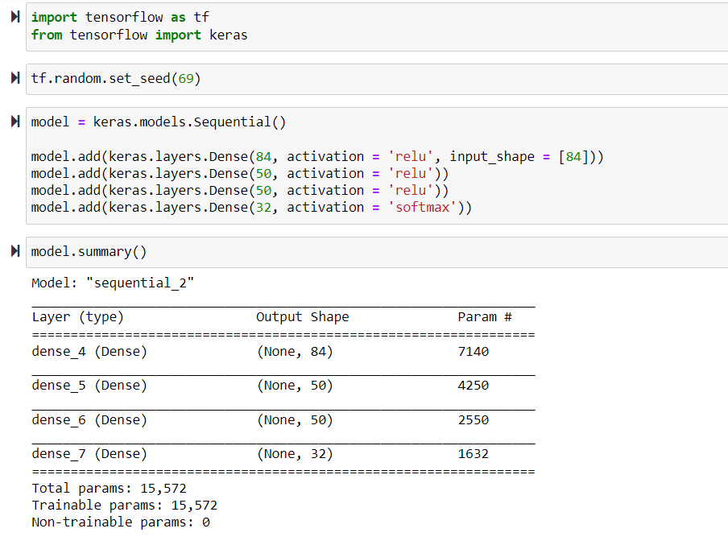
Approach 2 – Deep Learning
ANN (Artificial Neural Network) model creation.
Tensorflow and Keras are used for this model creation.
1 input layer
2 hidden layers
1 output layer
This is a 84-50-50-32 network.

Slide 12
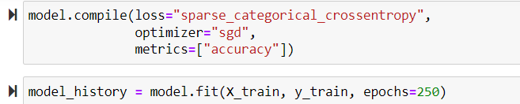
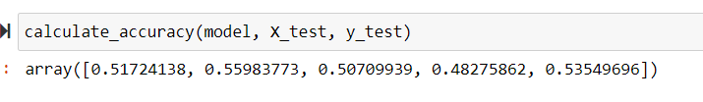
Approach 2 – Deep Learning
We are training the model and measuring its accuracy and loss function.

Slide 13
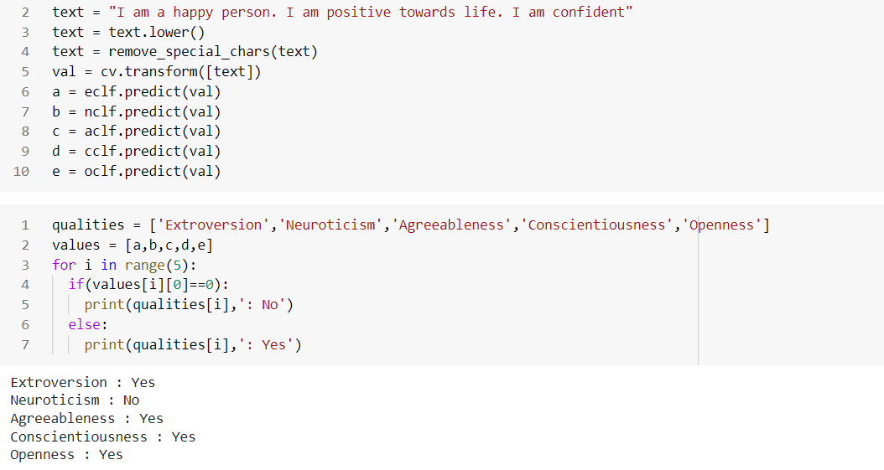
Testing

Slide 14
Further Prospects
To further improve the accuracy.
To incorporate new technology.
A depression detection tool may be created by comparing the texts of the same person over a period of time.
Trying out better deep learning approaches.
Using NLTK (Natural Language Toolkit)
Creating a front end for a better user interface and an accessible website.

Slide 15

THANK YOU

